Slide 1
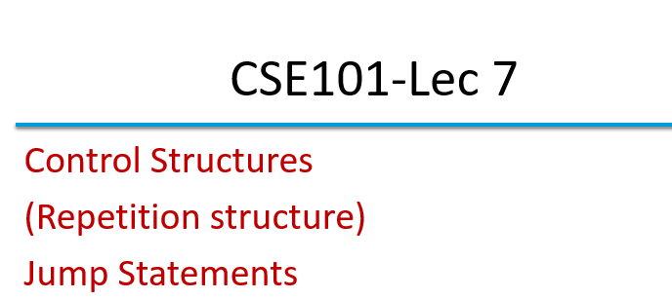

Slide 2
Outline
Jump Statements
break
continue
goto
return

Slide 3
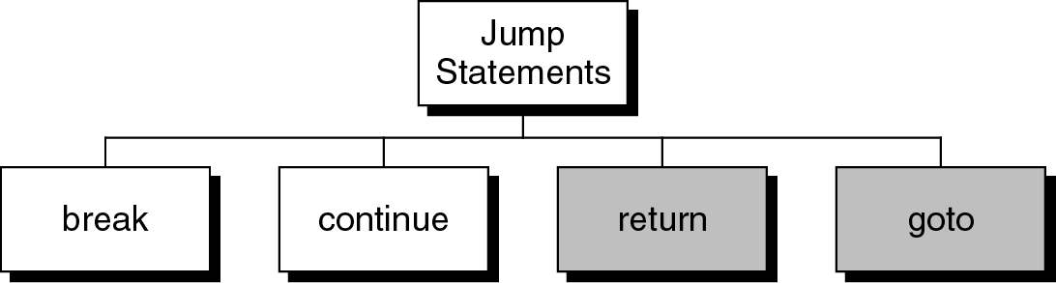
Jump statements
You have learn that, the repetition of a loop is controlled by the loop condition.
C provides another way to control the loop, by using jump statements.
There are four jump statements:

Slide 4
break statement
break is a keyword.
break allows the programmer to terminate the loop.
A break statement causes control to transfer to the first statement after the loop or block.
The break statement can be used in nested loops. If we use break in the innermost loop then the control of the program is terminated only from the innermost loop.

Slide 5
break statement
##include<stdio.h>
int main()
{
int n;
for (n=10; n>0; n=n-1){
if (n<8)
break;
printf(“%d ”, n);
} //end for
}
Program to show use of break statement.
10 9 8

Slide 6
continue statement
continue statement is exactly opposite to break.
continue statement is used for continuing the next iteration of the loop statements
When it occurs in the loop, it does not terminate, but skips the statements after this statement

Slide 7
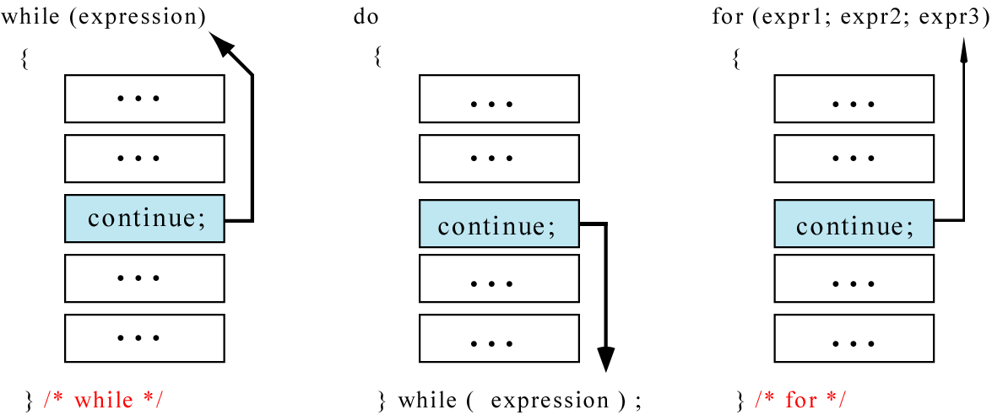
continue statement
In while and do…while loops, the continue statement transfers the control to the loop condition.
In for loop, the continue statement transfers the control to the updating part.

Slide 8
continue statement
#include<stdio.h>
int main()
{
int n;
for (n=10; n>0; n=n-1){
if (n%2==1)
continue;
printf(“%d ”, n);
}
}
Program to show the use of continue statement in for loop
10 8 6 4 2

Slide 9
continue statement
#include<stdio.h>
int main()
{
int n = 10;
while(n>0){
printf(“%d”, n);
if (n%2==1)
continue;
n = n –1;
}
}
Program to show the use of continue statement in for loop
For n=9, loop goes to infinite
execution
The loop then prints number 9 over and over again. It never stops.
10 9 9 9 9 9 …………

Slide 10
goto
Unconditionally transfer control.
goto may be used for transferring control from one place to another.
The syntax is:
goto identifier;
Control is unconditionally transferred to the location of a local label specified by identifier. For example,
Again:
...
goto Again;

Slide 11
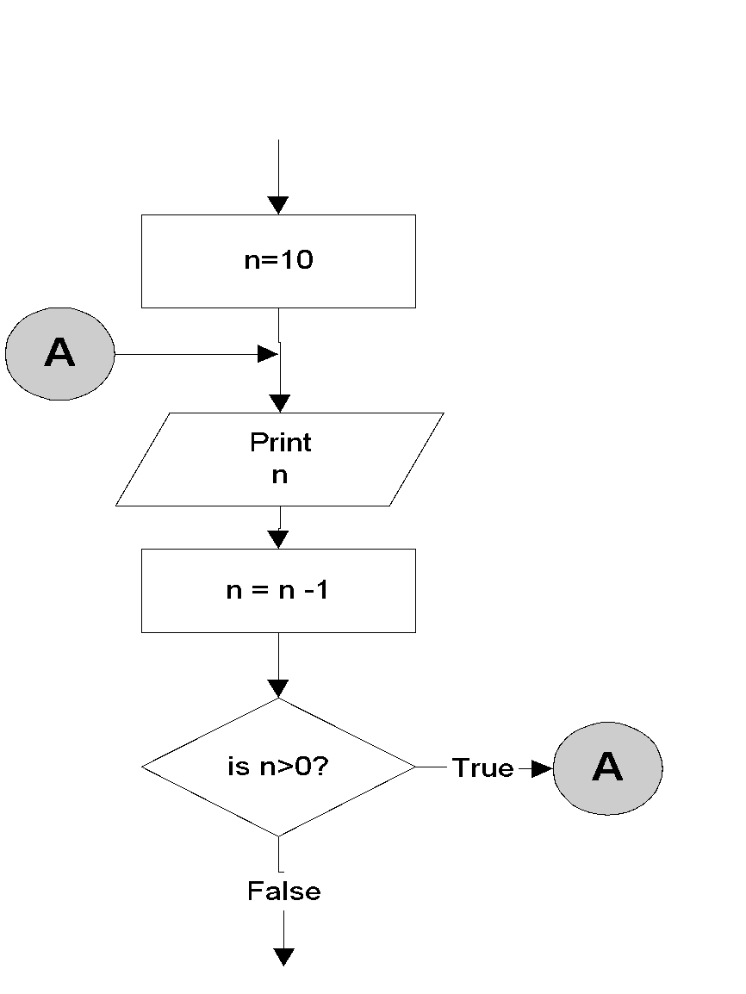
goto statement
n=10;
A:
printf(“%d “, n);
n = n -1;
if (n>0)
goto A;
Output:
10 9 8 7 6 5 4 3 2 1

Slide 12
Program to show goto statement.
#include<stdio.h>
void main()
{
int x;
printf(“enter a number: ”);
scanf(“%d”,&x);
if(x%2==0)
goto even;
else
goto odd;
even:
printf(“ %d is even”, x);
return;
odd:
printf(“%d is odd”, x);
}
enter a number: 18
18 is even

Slide 13
return statement
Exits the function.
return exits immediately from the currently executing function to the calling routine, optionally returning a value. The syntax is:
return [expression];
For example,
int sqr (int x){
return (x*x);
}

Slide 14
Question 1
The continue statement cannot be used with A. for B. while C. do while D. switch

Slide 15
Answer 1
The continue statement cannot be used with A. for B. while C. do while D. switch

Slide 16
Question 2
Which keyword can be used for coming out of recursion? A. return B. break C. exit D. both A and B

Slide 17
Answer 2
Which keyword can be used for coming out of recursion? A. return B. break C. exit D. both A and B

Slide 18
Question 3
Switch statement accepts.
A. int B. char C. long D. All of the above

Slide 19
Answer 3
Switch statement accepts.
A. int B. char C. long D. All of the above

Slide 20
Question 4
Which loop is guaranteed to execute at least one time.
A. for B. while C. do while D. None of the above

Slide 21
Answer 4
Which loop is guaranteed to execute at least one time.
A. for B. while C. do while D. None of the above

Slide 22
Question 5
A labeled statement consist of an identifier followed by A. ; B. : C. , D. =

Slide 23
Question 5
A labeled statement consist of an identifier followed by A. ; B. : C. , D. =

